Slide 1
New Commodore 64 Network Game Developments
Leif Bloomquist
Emergency Chicagoland Commodore Convention
September 28, 2013

Slide 2
History
Numerous Ethernet & TCP/IP solutions for the Commodore 64 since 2003!
The Final Ethernet, RR-Net, FB-Net, 64NIC+ all based on CS8900 chip
Plus other unique solutions: Comet, Flyer, ETH64, Wiz5100, RN-XV
Plenty of tools – Disk imaging, File transfer, Telnet clients, Cross-development, Chat, Operating Systems, etc.
How about some games?

Slide 3
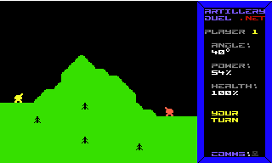
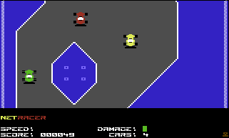
History continued
Artillery Duel Network (2006)
Turn-based
One-on-one
Minimal game world
NetRacer (2008)
Realtime
Multiplayer (8 player limit)
Introduced a server
Larger but static game world

Slide 4
What Next?
Ready to tackle something more ambitious! (2013)
Realtime
“Massively” multiplayer (unlimited)
Server-controlled entities
More complex gameplay with multiple goals, encouraging teamwork
Massive, dynamic game world

Slide 5
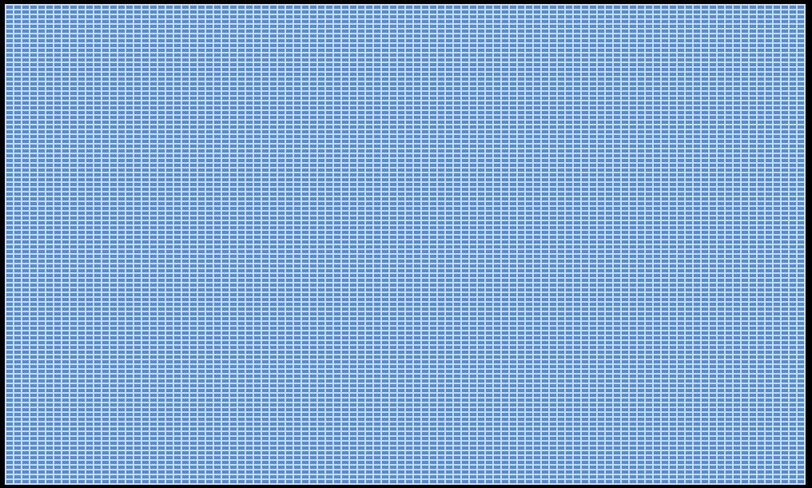
How massive? Target: 10,000 screens
100 screens wide
100 screens high
Each screen 40 x 25 character cells
Total of 10,000,000 character cells or 640,000,000 pixels

Slide 6
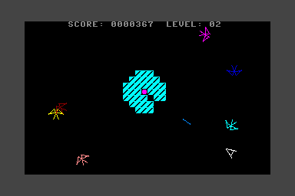
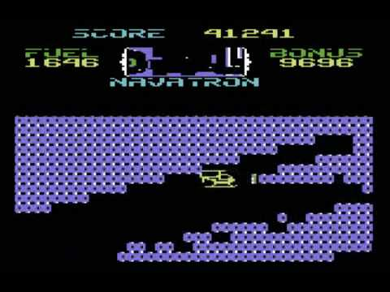
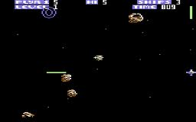
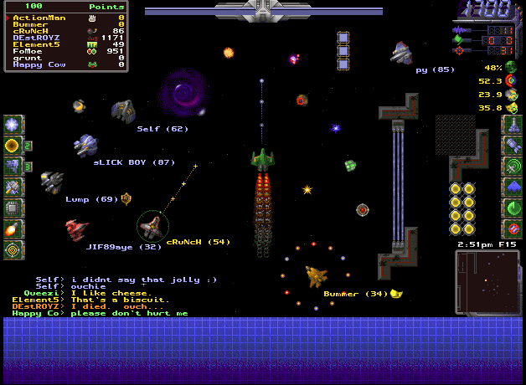
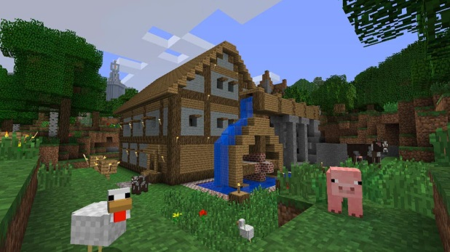
Inspiration
Vortex (C64)
Zone Ranger (C64)
Fort Apocalypse (C64)
Subspace (PC)
Minecraft (PC)

Slide 7
The Game: Vortex 2
“Sequel” to the original game Vortex (Ahoy! Magazine Jan. 1987)
Fast-paced overhead 2D space shoot-em’ up
Dogfight with alien ships, seek powerups, save the universe
Teamwork encouraged!
Many gameplay details to be worked out

Slide 8
Status
First draft of design documents written
Server is in place (VPS running Ubuntu Server 12.04)
Proof-of-concept Server code running
Proof-of-concept Client code working
Fly around and explore
Initial version of graphics and charset ready
Coordinating through Github and Google Groups

Slide 9
Technical Design Decisions
Server will control bulk of game logic
Server will arbitrate collisions, actions, etc.
Screen and sprite location data to be “streamed” by server to C64 clients in real-time (20 Hz)
Sprite/character data to be sent to client on startup
Player inputs and location to be sent from C64 to server (20 Hz)
Server language: Java 7
Client language: ca65 cross-assembler
IP65 network library

Slide 10
Technical Challenges
Finding enough raster time
Handling the 8-sprite limit on C64 (can’t multiplex)
Algorithmic generation of game “universe”
Future: Multiple clients?? (Android, iOS, Apple II?)

Slide 11
The Team
Development:
Leif Bloomquist (Concept, Networking, Server code)
Saul Cross (Graphics)
Bryce Wilson (Client code)
Robin Harbron (Advice)
Support:
Jonno Downes (IP65 networking code)
Dan Roganti, Rob Adlers (Playtesting)
…and you? Join us!

